Slide 1
Policy Gradients DRL
Habibi Imen 09/03/2025

Slide 2
Policy
In reinforcement learning, the agent’s policy refers to the algorithm it uses to decide its action based on its observations of the environment. The goal in RL problems is to maximize the rewards the agent earns from interacting with the environment. The policy that results in the maximum rewards is the optimal policy
It can be:
Deterministic: A single action is chosen for each state (e.g., always move left).
Stochastic: Actions are chosen probabilistically (e.g., move left with 70% probability, right with 30%).
2

Slide 3
Policy-based Methods
Value-based methods
Directly optimize the policy using gradient ascent on expected rewards.
Do not rely on a value function.
Represent the policy in a parametrized form, often using a neural network.
The neural network learns the optimal policy by adjusting its weights through gradient ascent.
Estimate the value of states or state-action pairs.
Derive the policy by selecting actions with the highest value.
The optimal policy is the one that maximizes the value function.
The Bellman equations define the optimal state-value and state-action value functions.
3

Slide 4
Policy Gradient methods optimize the policy directly by calculating the gradient of the expected return (cumulative rewards) with respect to the policy parameters. These parameters are typically represented by the weights of a neural network. By updating these parameters in the direction that increases the expected return, the policy improves over time.

Slide 5
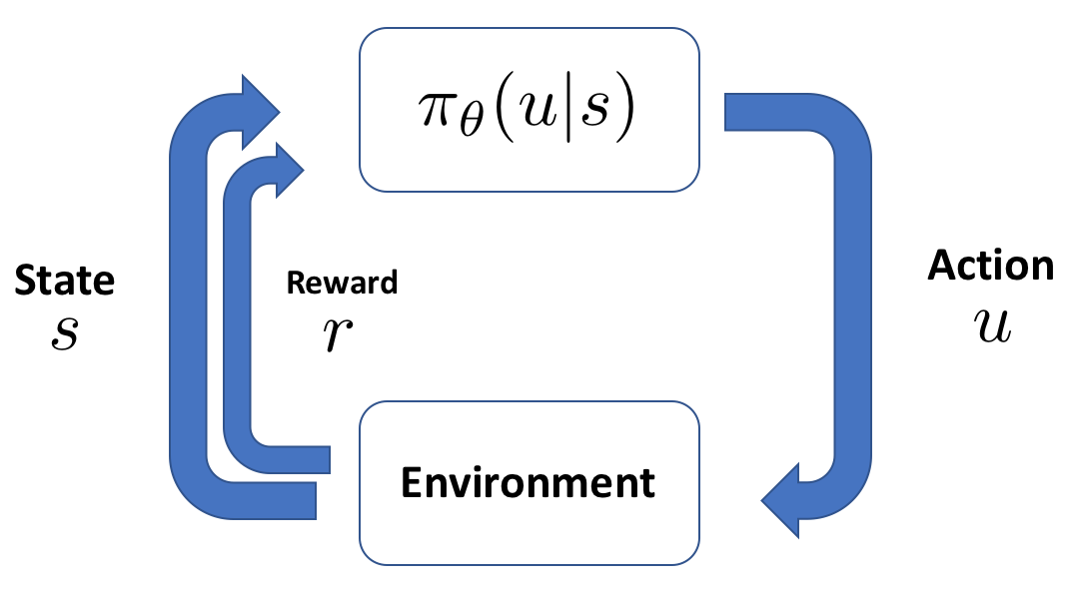
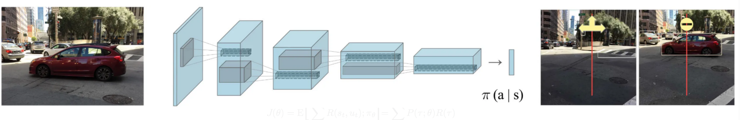
Policy Gradients focus on stochastic policies, which are represented as a probability distribution over actions:
Π_θ​(u∣s)=P(u∣s; θ)
The probability of taking the action u given a state s.
π is the policy in RL. θ represents the parameters of the policy (e.g., weights of a neural network).
For example, what is the chance of turning or stopping when you see a car in front:
Turn Left (u1​): P(u1∣s)=0.3 (30% chance)
Turn Right (u2​): P(u2∣s)=0.2 (20% chance)
Stop (u3): P(u3∣s)= (50% chance)

Slide 6
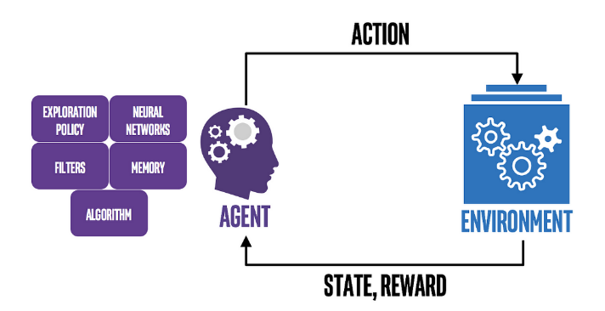
Why Use Policy Gradient Methods?
Handling Complex Action Spaces: Policy gradient methods efficiently handle high-dimensional or continuous action spaces by parametrizing the policy and directly optimizing it using gradients. This approach is better suited for environments with large or continuous action spaces, like robotic control, and also supports Reinforcement Learning with Human Feedback (RLHF).
Learning Stochastic Policies for Exploration: Policy gradient methods learn stochastic policies that assign probabilities to actions, promoting exploration and preventing the agent from getting stuck in local optima. This stochastic nature enables better generalization and exploration, making it ideal for complex environments with intricate reward structures.

Slide 7
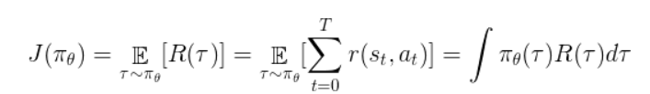

Mathematical Formulation
The objective function
The objective function we want to maximize is:
Where:
τ is a trajectory: τ=(s0,a0,r0,s1,a1,r1,… )
R(τ) is the total reward for the trajectory, often discounted:
​
γ is the discount factor (0 < γ ≤ 1), which reduces the importance of future rewards.
πθ​ is the policy parameterized by θ

Slide 8

We will employ gradient ascent to move the parameters of our function in the direction what increases the expectation of the return, which will make the received rewards go up. In order to be able to execute the gradient ascent algorithm, we will need to calculate the gradient of this function. We will move the parameters θ of our policy π in the direction indicated by the gradient of the return:

Slide 9




To calculate the gradient of the return, ∇ J(π), we will begin by calculating the gradient of the policy function ∇ π(τ). For that, we will use two tricks that will make the math much easier to understand. The first one is consists of multiplying the gradient by the constant π(τ). The gradient of our policy function with respect to the parameters θ is then:
10

Slide 10

The second trick is to remember that the derivative of ln(x) is equal to 1/x. Therefore, the derivative of ln(f(x)) will be (1/f(x)) * f´(x). To simplify the notation, we will generalize the logarithm as ¨log¨ from now on. The gradient of our policy function is :

Slide 11
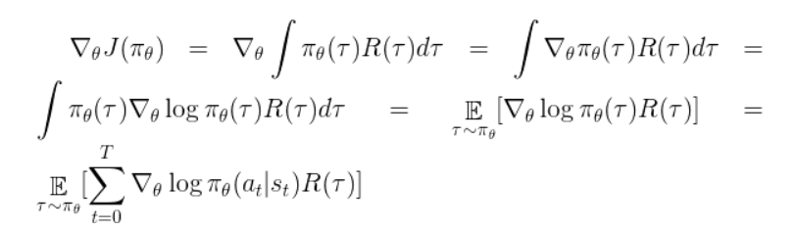
Now that we have calculated the gradient of the policy, let’s use it to calculate the gradient of the return, which is what we want to maximize. This is the final policy gradient that we will use.

Slide 12
This is the simplest form of the final policy gradient for policy-based algorithms.
We will move the parameters of our policy function in the direction that increases R(τ).
This version of the policy gradient has high variance, and it is not completely adequate for complicated environments. It will be appropriate for now, but in the next few parts we will see how it can be improved. We will implement an algorithm that uses this gradient to improve the policy.

Slide 13

REINFORCE Algorithm
REINFORCE is a Monte Carlo Policy Gradient algorithm, where updates happen after a full episode.
Step 1: Collect Trajectories
Execute the policy πθ for a full episode.
Store the states, actions, and rewards
Step 2: Compute Total Return
For each time step t, compute the discounted return:
where: Γ is the discount factor that controls the importance of future rewards.
10

Slide 14


Step 3: Compute Policy Gradient Estimate
The REINFORCE algorithm updates policy parameters using gradient ascent:
This means:
If G_​t is high, increase the probability of action at.
If Gt is low, decrease the probability of action at.
Step 4: Update the Policy
Using stochastic gradient ascent:
where: α is the learning rate.
10

Slide 15
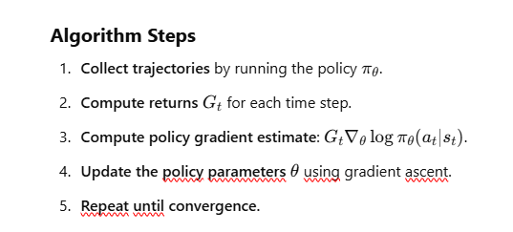
Algorithm Steps
Collect trajectories by running the policy .
Compute returns for each time step.
Compute policy gradient estimate: .
Update the policy parameters using gradient ascent.
Repeat until convergence.

Slide 16
Policy Gradient Theorem ensures we are improving the probability of good actions.
Using Monte Carlo estimation, we rely on full episodes for updates.
Challenges
🚫 High variance: Returns Gt can fluctuate a lot, making learning unstable. 🚫 Slow convergence: Since updates only happen after full episodes. 🚫 Sensitive to hyperparameters: Learning rate α\alphaα, discount factor γ, etc
Ways to Improve REINFORCE
✅ Baseline Subtraction: Reduce variance by subtracting a baseline b(st). ✅ Actor-Critic Methods: Introduce a value function to stabilize training. ✅ Advantage Estimation: Use A(s,a)=Gt−V(s) instead of raw rewards.
4

Slide 17


REINFORCE with Baseline (Variance Reduction)
One major issue with REINFORCE is its high variance. We introduce a baseline function to reduce variance while keeping the gradient unbiased:
A common choice for the baseline is the state value function:
which estimates the expected return given the state .
4

Slide 18

Effect of the Baseline:
We now show that the gradient remains unchanged by the addition of a baseline:
The baseline term is constant with respect to the policy parameters, and therefore its gradient is zero.
The result is that adding a baseline does not change the gradient, but it reduces the variance of the gradient estimate, which leads to more stable training.
4

Slide 19
Actor-Critic Methods
Actor-Critic methods use both an actor and a critic. The actor is responsible for selecting actions (policy), while the critic estimates the value function. The key challenge in Actor-Critic methods is choosing an appropriate baseline for the critic and computing gradients for both the actor and the critic.
The actor updates the policy by computing the policy gradient based on feedback from the critic.
The critic provides an evaluation of the state-action values, guiding the actor to improve its policy.
In this framework:
The critic computes the state value function Vω(s)
The actor computes the policy parameters that maximize the expected return, guided by the critic's evaluations.
4

Slide 20

One-Step Bootstrapped Return
The One-Step Bootstrapped Return is a simplified way to estimate the return by using the immediate reward and bootstrapping the value of the next state. The bootstrapped return is defined as:
Where:
Rt+1​ is the reward at the next time step,
γ is the discount factor,
Vω(St+1) is the value estimate of the next state.
This return is used in Actor-Critic methods to update the actor's policy and the critic's value estimates.
10

Slide 21

Actor-Critic Policy Gradient
The policy gradient for Actor-Critic methods, which uses the one-step bootstrapped return, is given by:
Where:
Rt+1​ is the immediate reward,
γVω(St+1) is the bootstrapped return estimate for the next state,
The term ∇θlog⁡πθ(at∣st) is the policy gradient with respect to the action taken.
This update rule enables both the actor and critic to update their parameters. The actor improves its policy based on the feedback from the critic, and the critic refines its value estimate to help guide the actor.
10

Slide 22


Critic's Objective
The critic aims to minimize the Mean Squared Error (MSE) between its predicted state-value Vω(st) and the actual return. The objective function for the critic is:
Where:
Rt+1 is the immediate reward,
γ is the discount factor,
Vω(St) is the critic's predicted value for state St​.
The gradient of the critic's objective function, which is used to update the critic’s parameters ω, is:
his gradient is used to update the critic's parameters in the direction that minimizes the prediction error, improving the critic's ability to estimate state values.
10

Slide 23
Proximal Policy Optimization (PPO)
Proximal Policy Optimization (PPO) is a reinforcement learning (RL) algorithm that improves policy optimization by limiting the size of updates to prevent drastic policy changes. It is an on-policy, actor-critic method that balances exploration and exploitation while maintaining stability and efficiency in training.
PPO is widely used in deep RL due to its sample efficiency, stability, and ease of implementation. It is an improved version of the Trust Region Policy Optimization (TRPO) algorithm but is computationally simpler.
4

Slide 24

PPO's Core Idea
The main innovation in PPO is restricting how much the policy updates in a single training step. Instead of applying unconstrained updates (which could drastically change the policy), PPO clamps the updates within a defined range.
This is achieved by defining a probability ratio that measures the difference between the new policy and the old policy:
Where:
πθ(at∣st)\pi_{\theta}(a_t | s_t)πθ​(at​∣st​) is the new policy probability of taking action ata_tat​.
πθold(at∣st)\pi_{\theta_{\text{old}}}(a_t | s_t)πθold​​(at​∣st​) is the old policy probability before the update.
If the ratio rt(θ)r_t(\theta)rt​(θ) becomes too large or too small, PPO clips it within a certain range to prevent drastic policy updates.

Slide 25
PPO's Objective Function
PPO optimizes the policy using the following clipped objective function:
Where:
AtA_tAt​ is the Advantage Function, which estimates how good an action is compared to the average action.
ϵ\epsilonϵ is a hyperparameter that determines the clipping range (typically ϵ=0.1\epsilon = 0.1ϵ=0.1 or ϵ=0.2\epsilon = 0.2ϵ=0.2).
Clipping prevents extreme updates, ensuring more gradual and stable training.
9

Slide 26
CartPole-v1 Environment (OpenAI Gym)
The CartPole-v1 environment is a classic reinforcement learning (RL) problem provided by OpenAI Gym. It is a simple yet effective environment for understanding RL algorithms such as Policy Gradient, Actor-Critic, PPO, DQN, and DDPG.
Objective of CartPole
The goal of the agent (controller) is to balance a pole on a moving cart.
The agent must apply force (left or right) to prevent the pole from falling over.
The episode ends if the pole tilts too much or the cart moves too far from the center.
9

Slide 27
Thank you for your attention
35

